Slide 1
Advanced pcb lab
Marvin the hackbut
By Ben De Lathouwer

Slide 2
Agenda
Designing a PCB

Slide 3
Goal of advanced pcb lab

Slide 4
Main micro controller
Purpose
Generating data for esp8266
Controlling levelshifter
Controlling hc-sr04
receiving data from the secondary controller

Slide 5
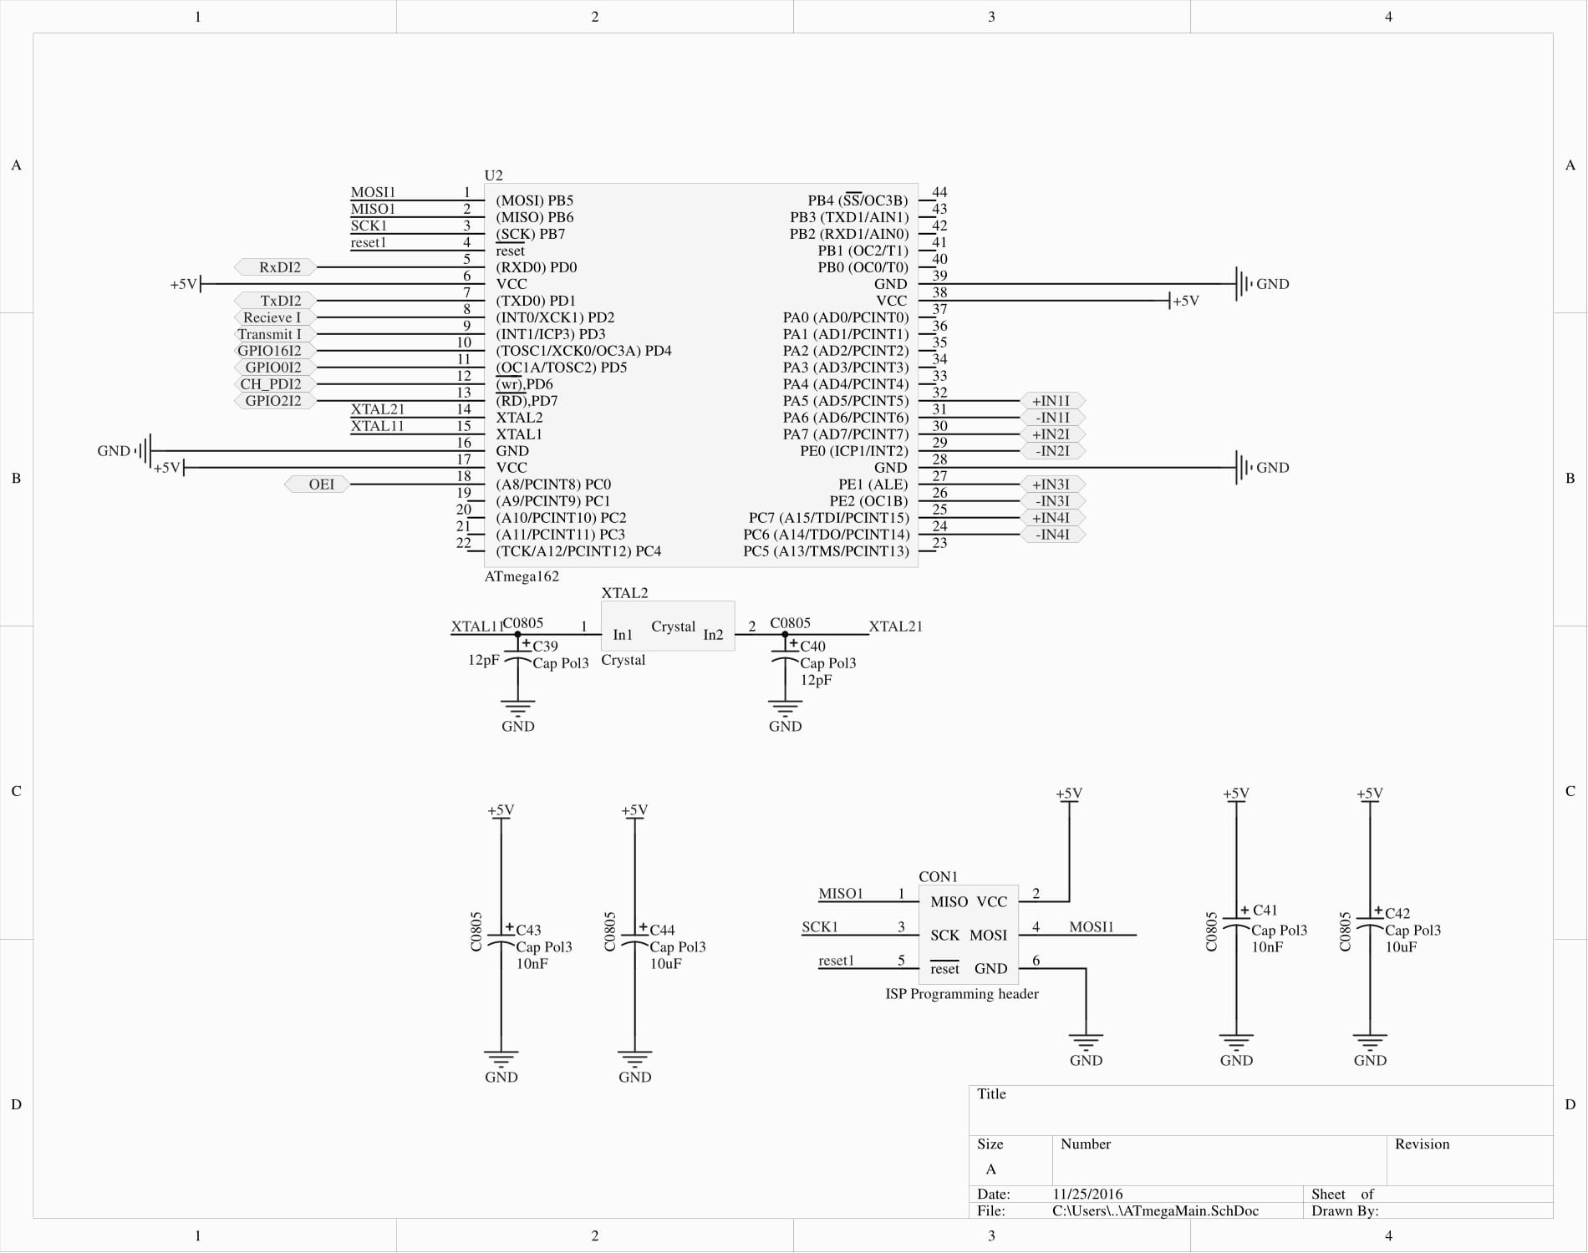
Main micro controller V2

Slide 6
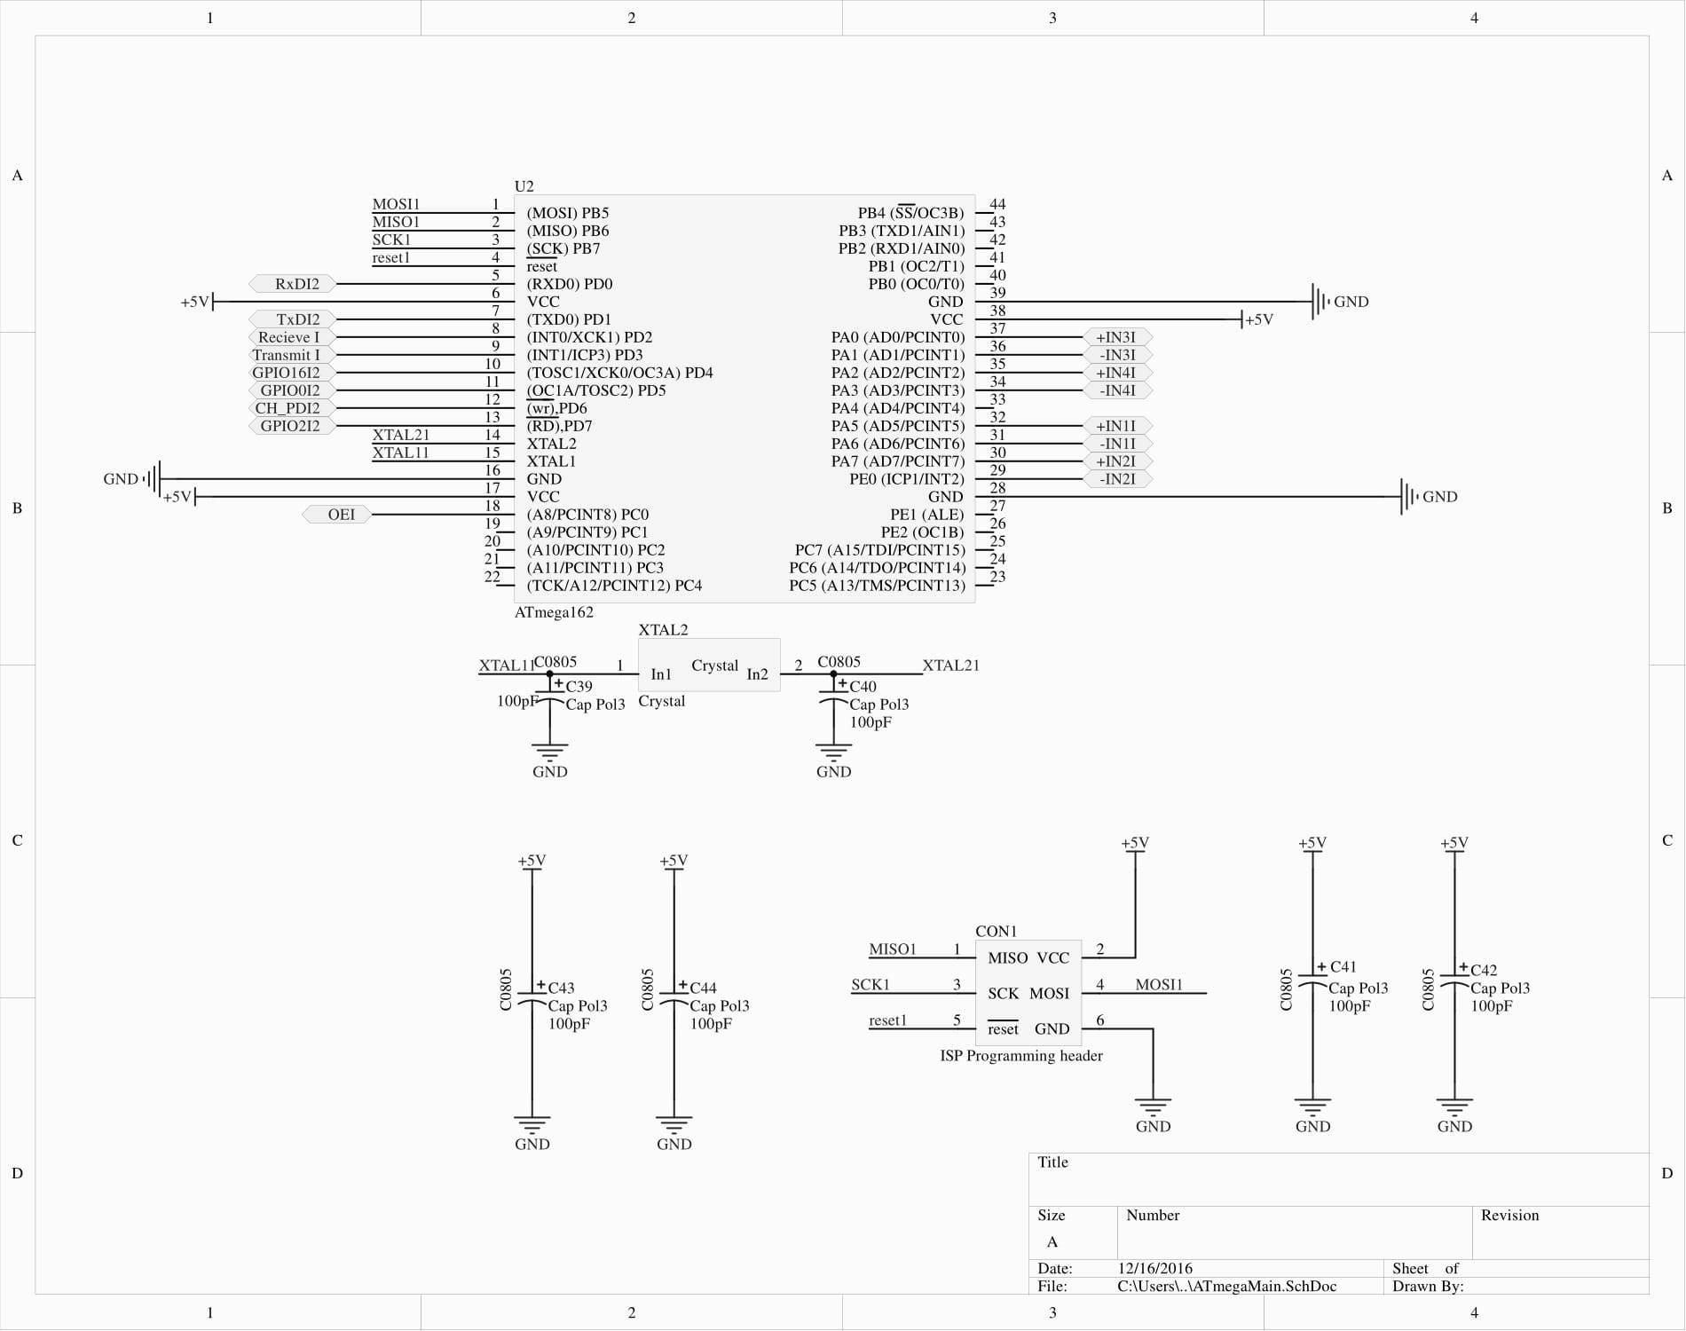
Main micro controller V3

Slide 7
Secondary micro controller
Purpose
Generating motor driver pwm
Controlling motordriver
Controlling hc-sr04
sending data to the main microcontroller

Slide 8
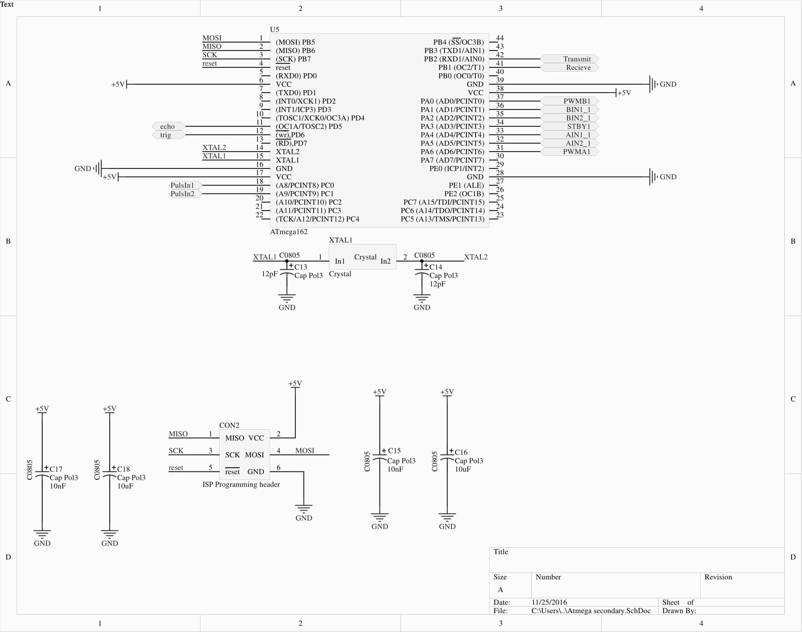
Secondary micro controller V2

Slide 9
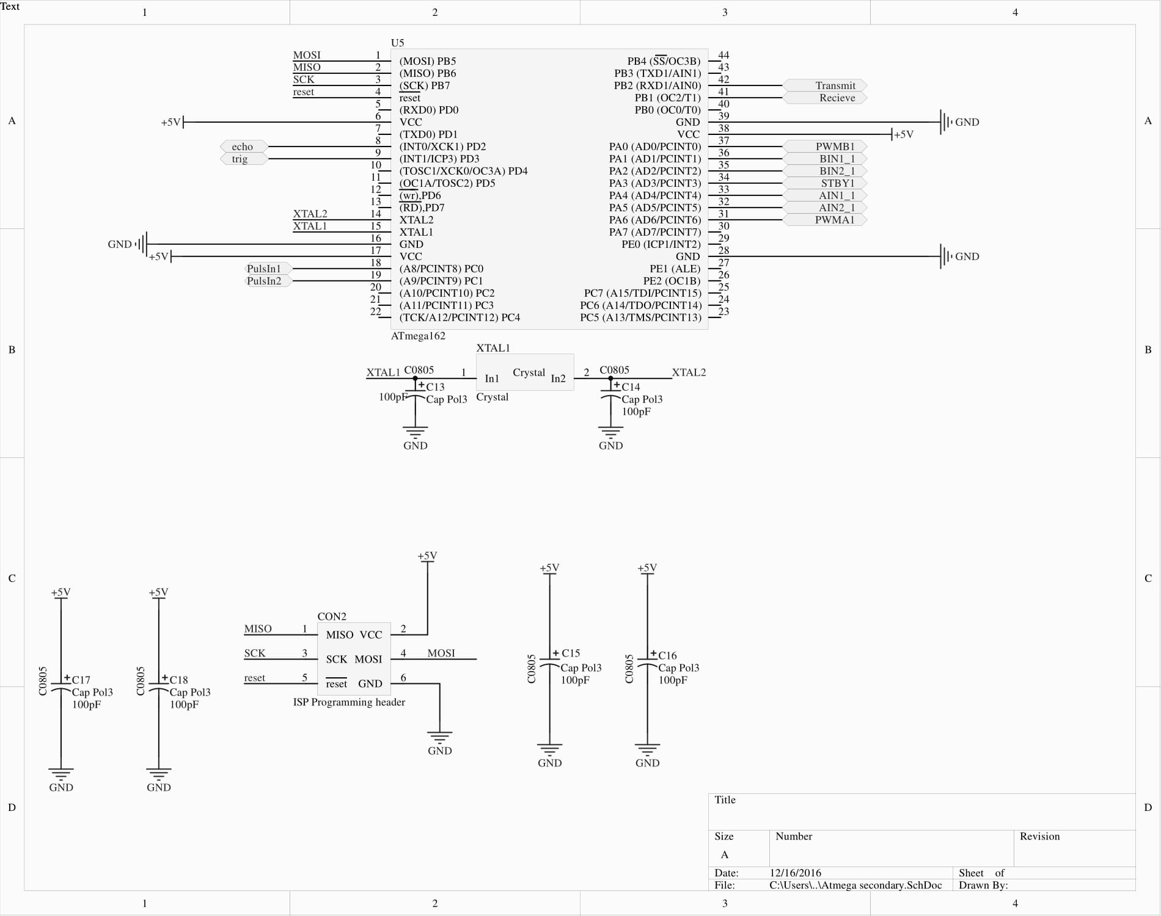
Secondary micro controller V3

Slide 10
Why to microcontrollers?
Taking load of the controller(interrupt wise)
Relatively more i/o available

Slide 11
Encoders
Rover chassis=> quadrature encoders
Number of sensors can be used
Optical(IR pair) => whit black and withe surfaces
Magnetical(hal sensor) => magnet on a shaft
Pulses 90degrees out of phase

Slide 12
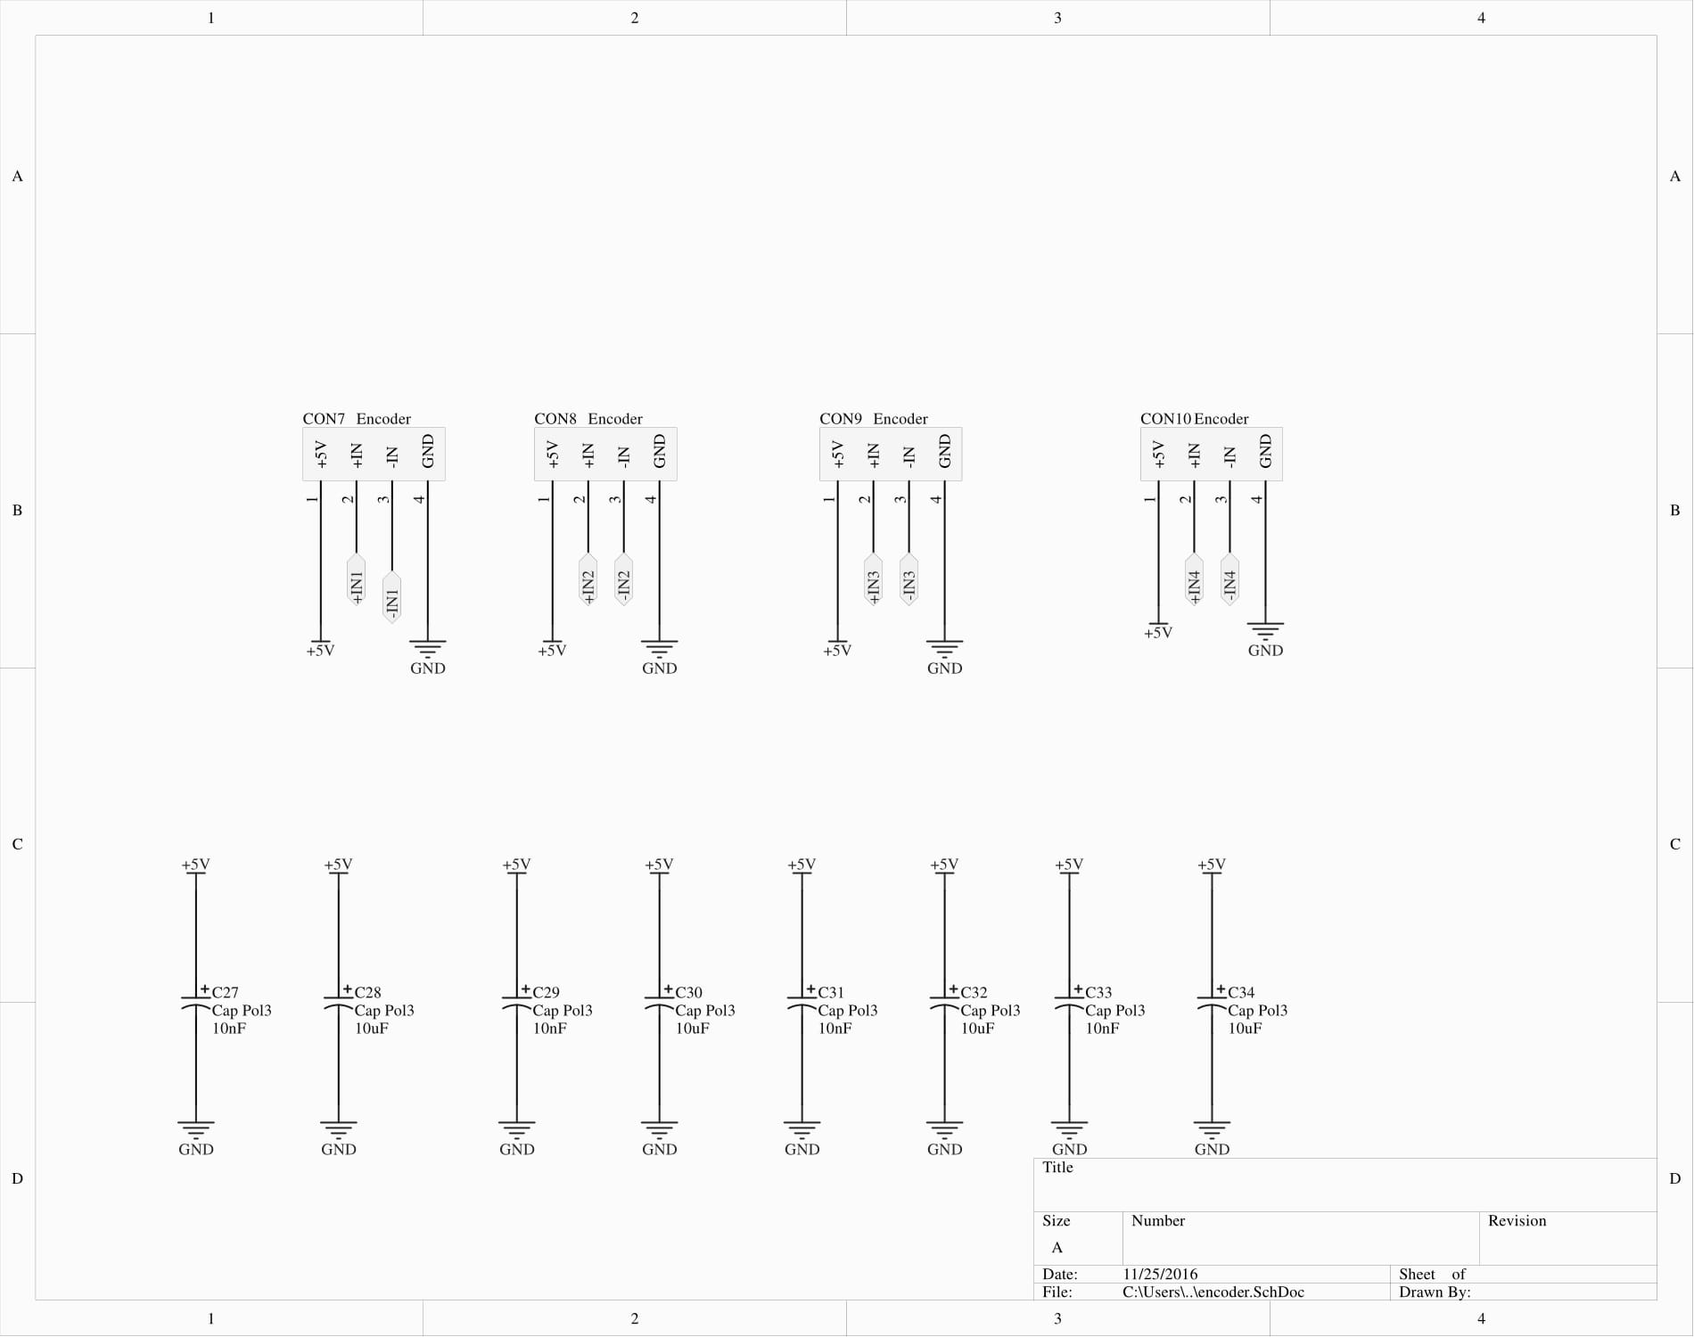
Encoders V2 & V3

Slide 13
ESP8266
Cheap wifi module (6 euro’s)
with onboard System On chip
Communicating protocol=> AT commands via serial port
No components under the antenna!
3.3V ONLY!!! No 5V tolerant I/O

Slide 14
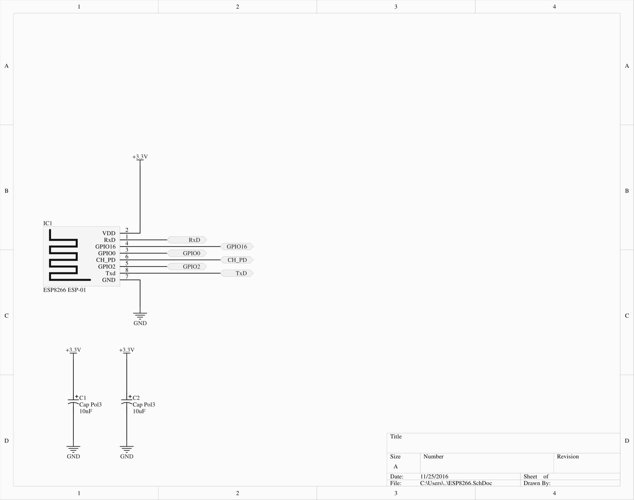
ESP8266 V2 & V3

Slide 15
Level shifter
Converts signal other voltage level
For example 3.3V to 5V
TXB0108 uses 2 voltage supply’s
Vcca => 1.2V to 3.6V
Vccb =>1.65V to 5.5V
Needs to be used because of the esp8266
Level shifter needs to be enabled via OE pin

Slide 16
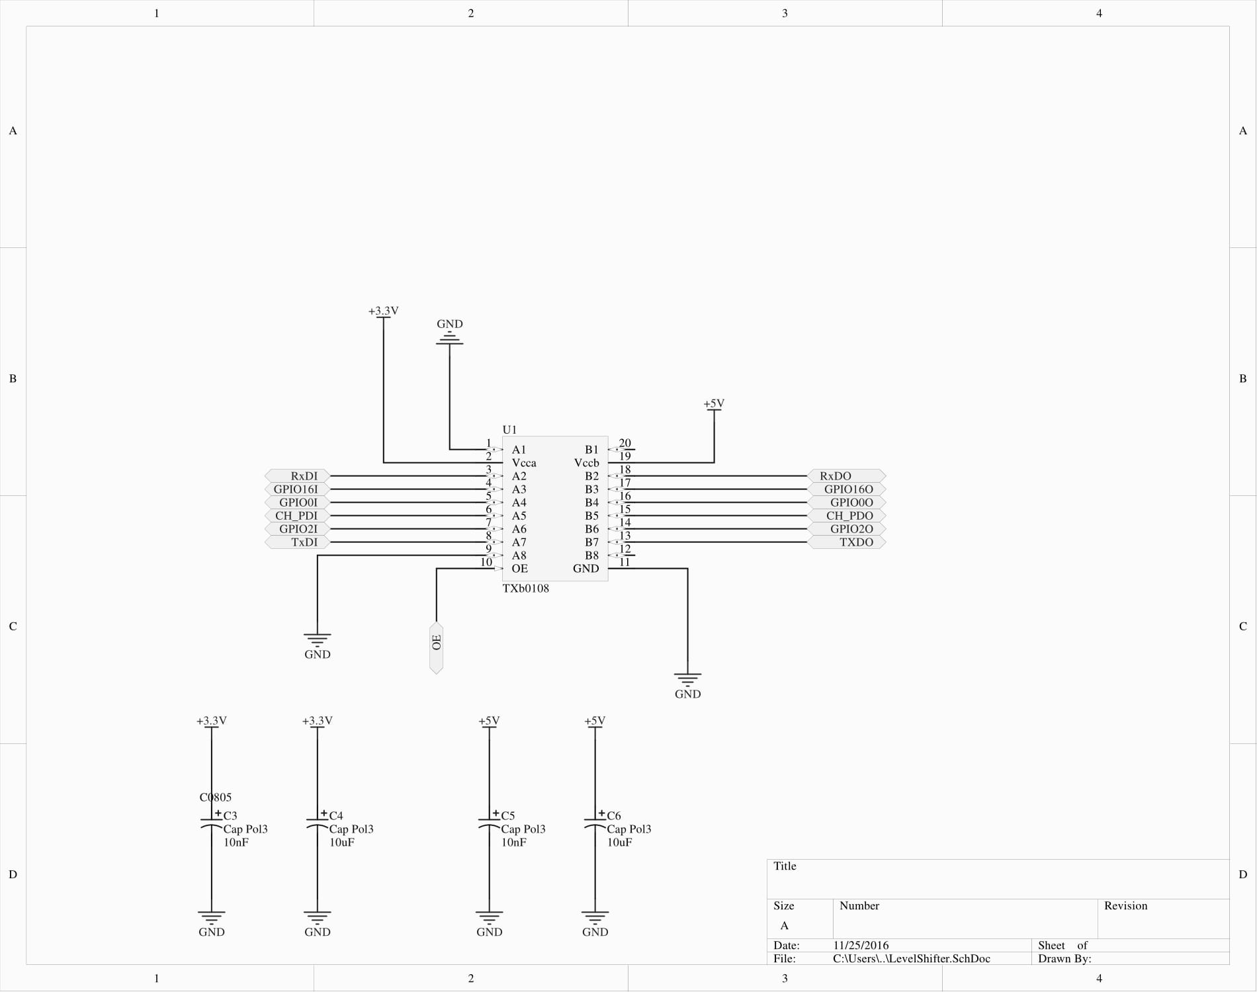
Level shifter V2 & V3

Slide 17
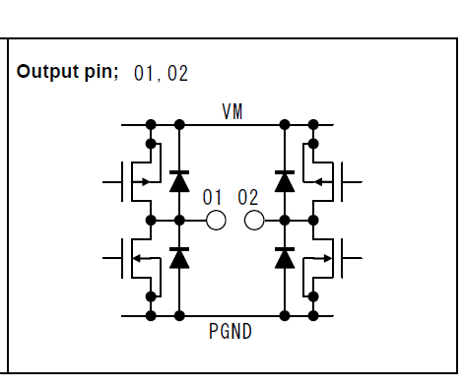
Motor driver
Using h-bridge
TB6612FNG
Integrated H-bridge with integrated control circuit’
No need to worry about short circuiting the internal mosfets
Iout 1.2A Max with peak current up to 3.2A

Slide 18
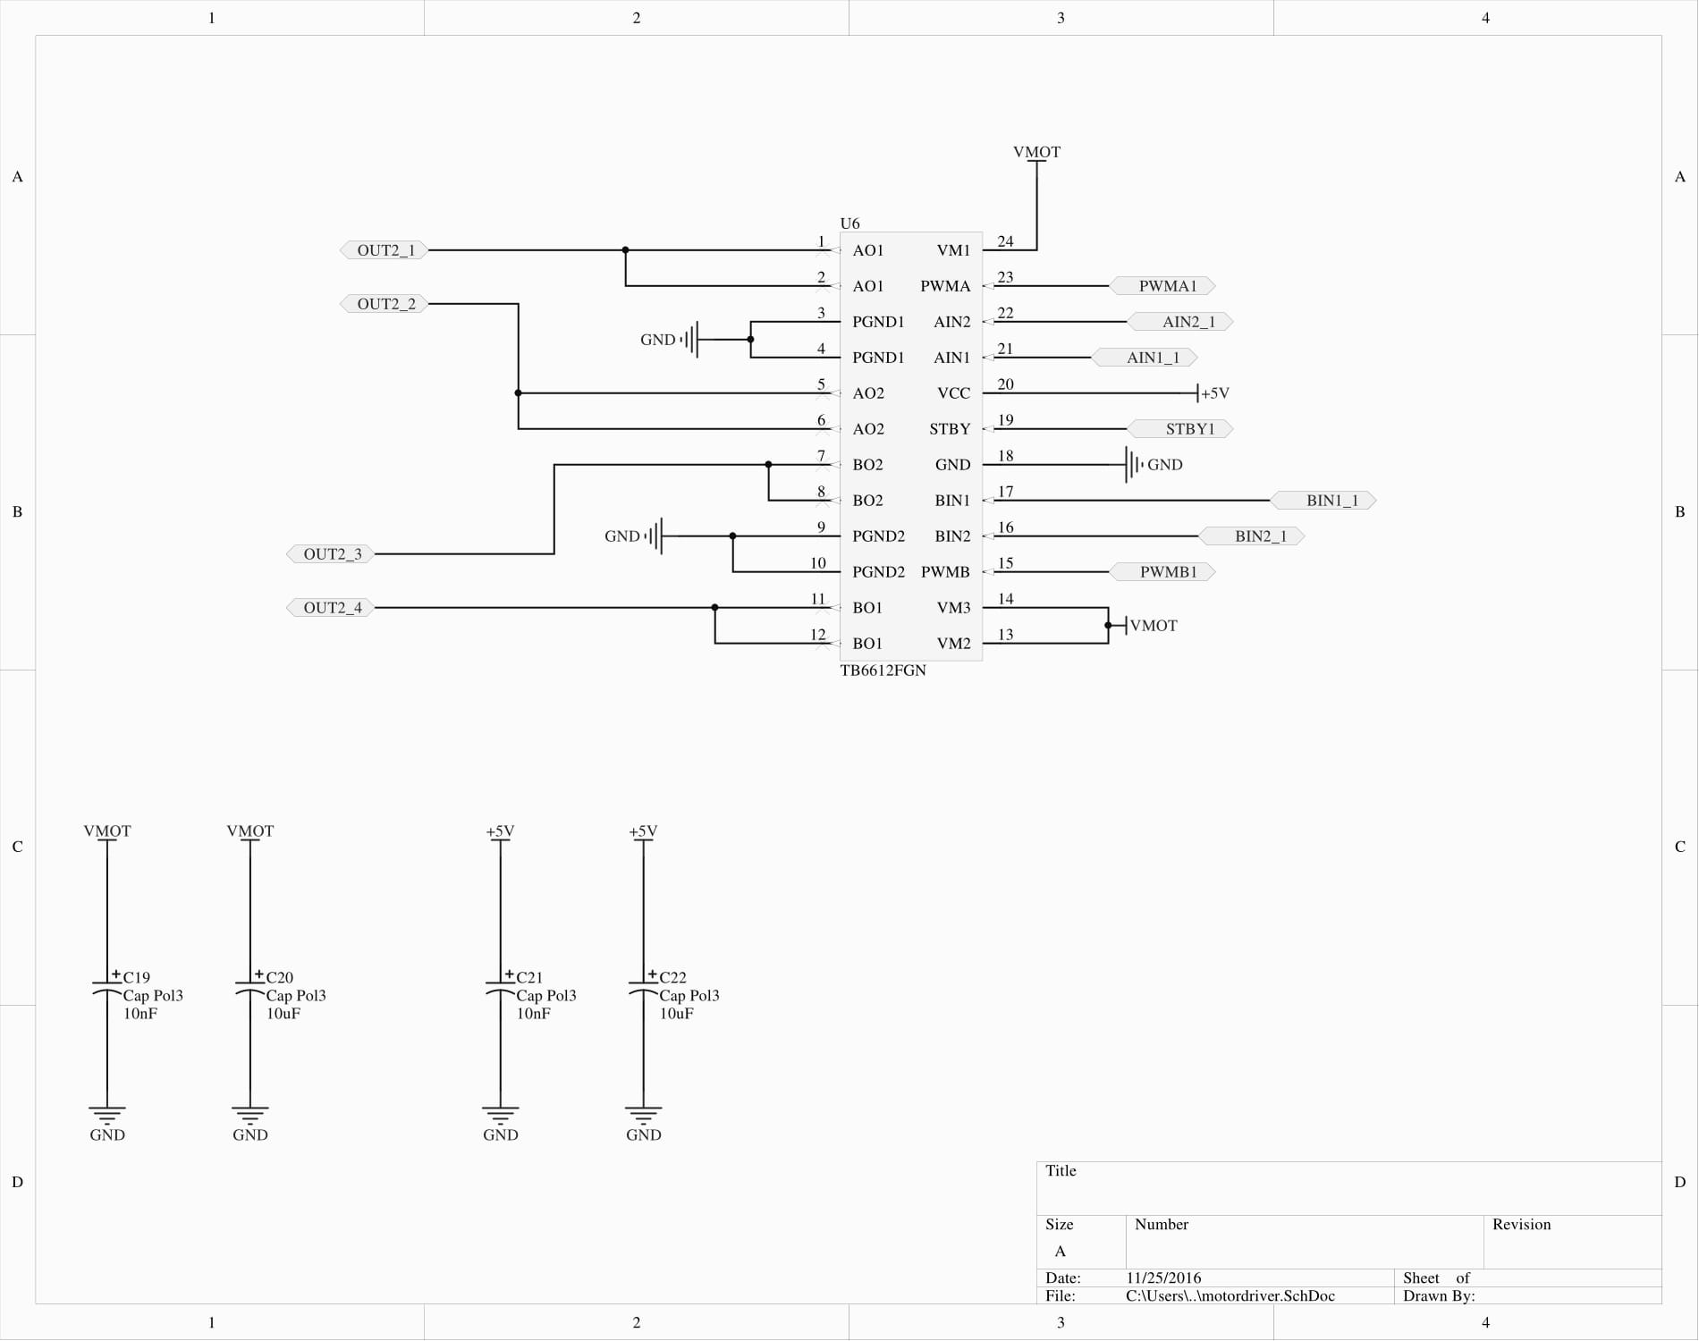
Motor driver V2 & V3

Slide 19
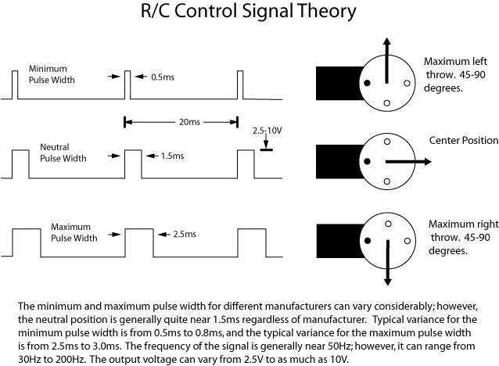
Rc reciever
Standart modelling rc receiver
Servo output
Wirles communication
Gets transformd into
Pwm signal

Slide 20
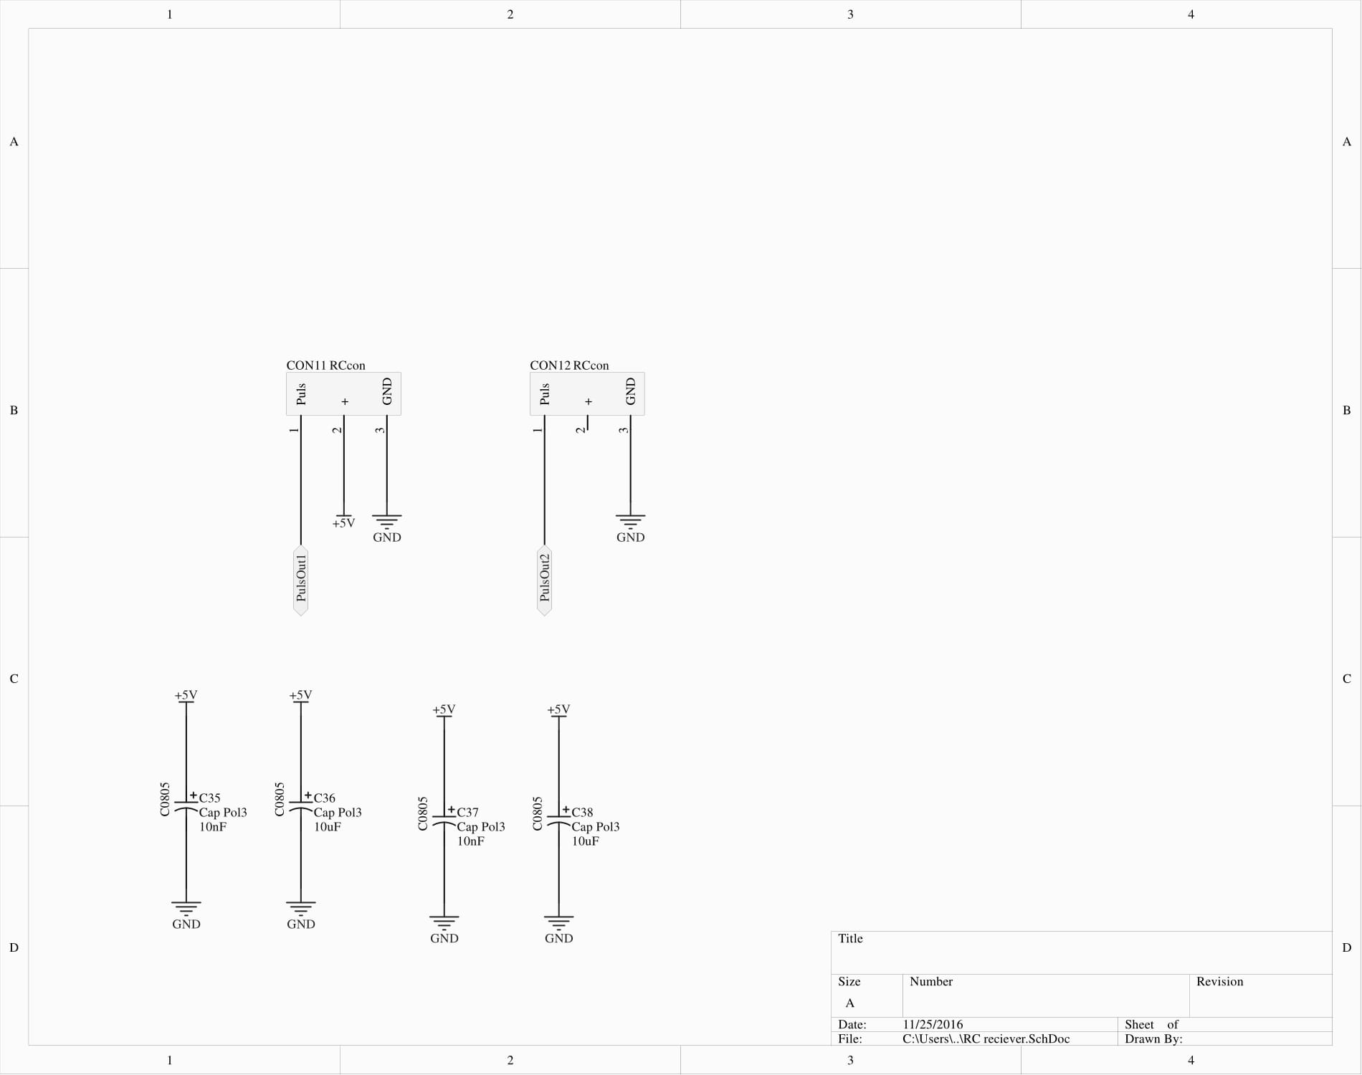
Rc receiver V2 & V3

Slide 21
Ultrasonic distance sensor
Measurement using sound
4 pins
Gnd, vcc triger input and echo output
Echo puls with proportional to distance
distance = high level time * velocity (340M/S) / 2
High level= duration of puls with(milli or micro seconds)
velocity = 340M/S

Slide 22
Ultrasonic distance sensor
Ranging distance = 4cm to 4meters
Detection angle is 15 degrees

Slide 23
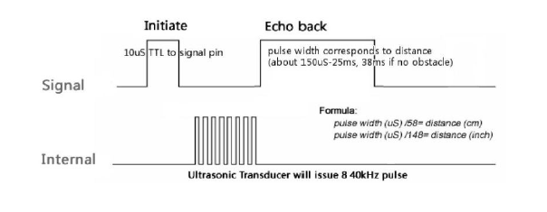
Theoretical signals

Slide 24
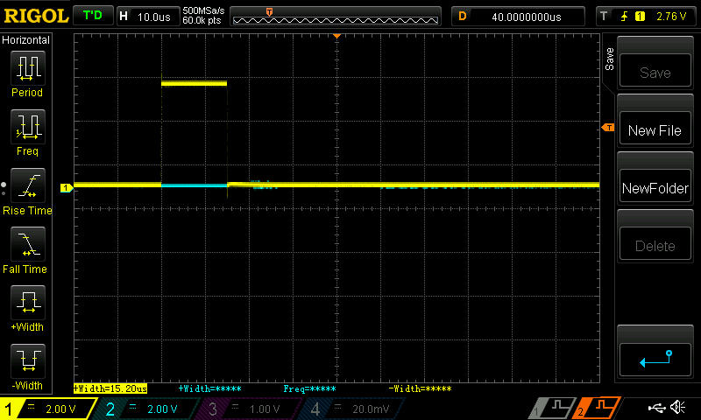
Trigger puls

Slide 25
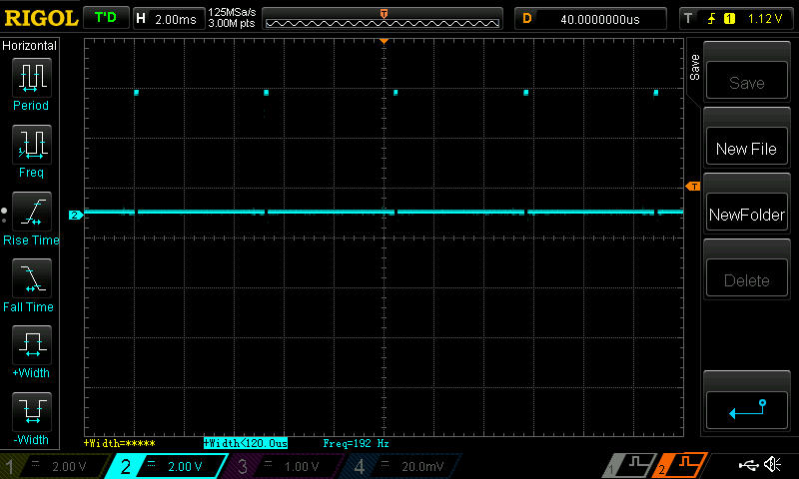
Echo puls minimum distance

Slide 26
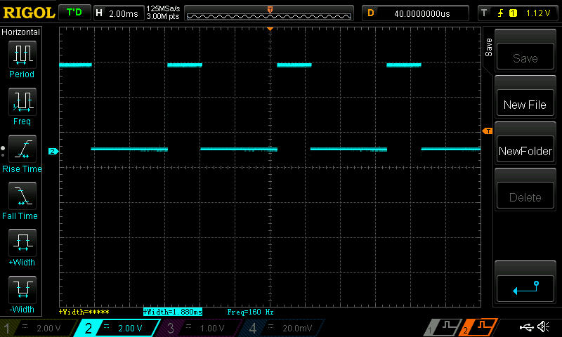
Echo puls max distance

Slide 27
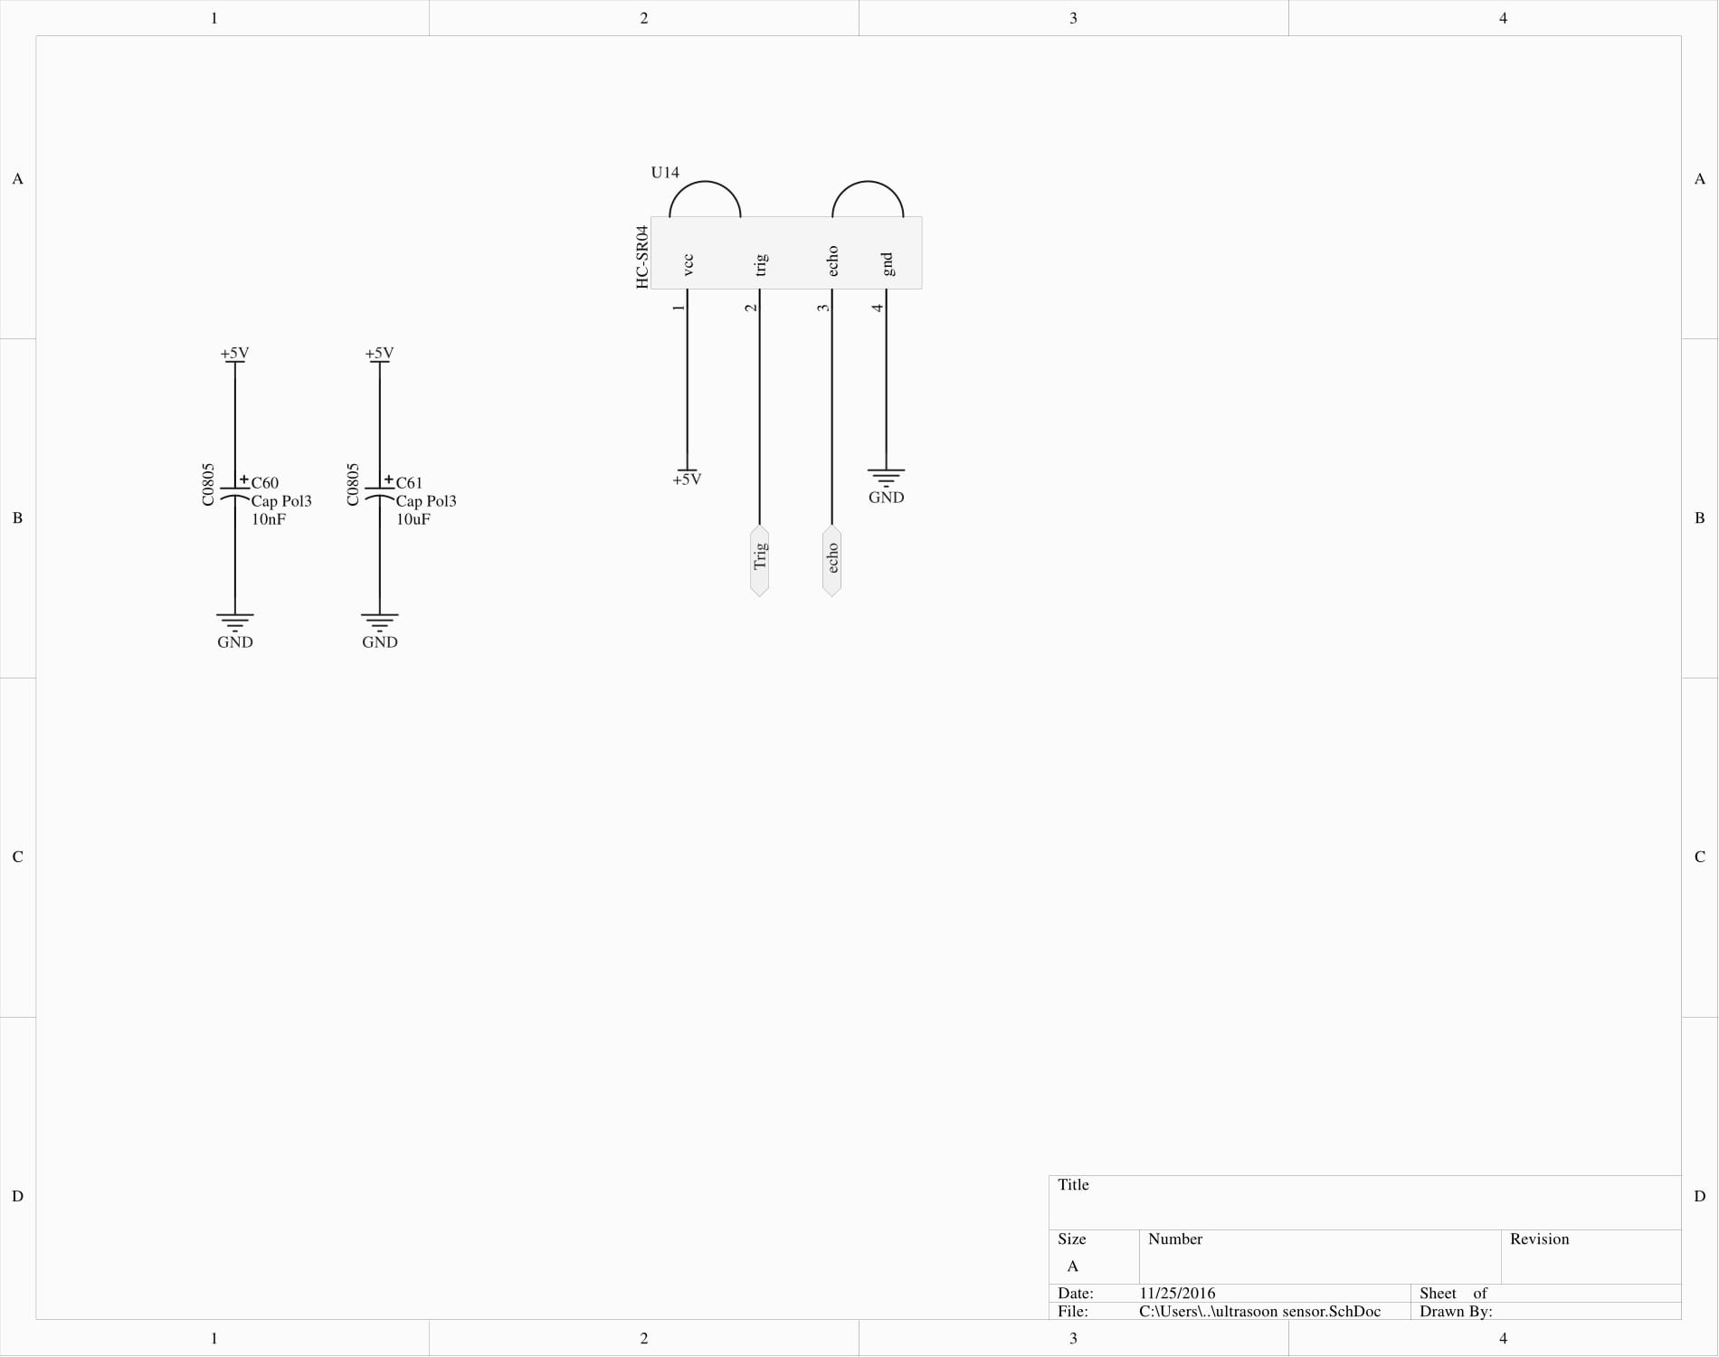
Ultrasonic distance sensor V2 & V3

Slide 28
Power supply
Uses ldo’s
Low dropout voltage
Used to generate 5V and 3.3V for control electronics

Slide 29
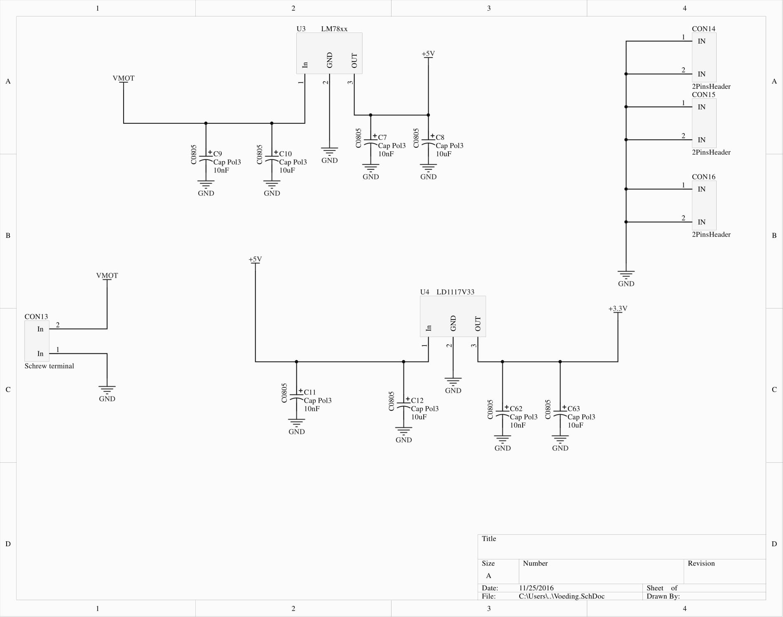
Power supply V2

Slide 30
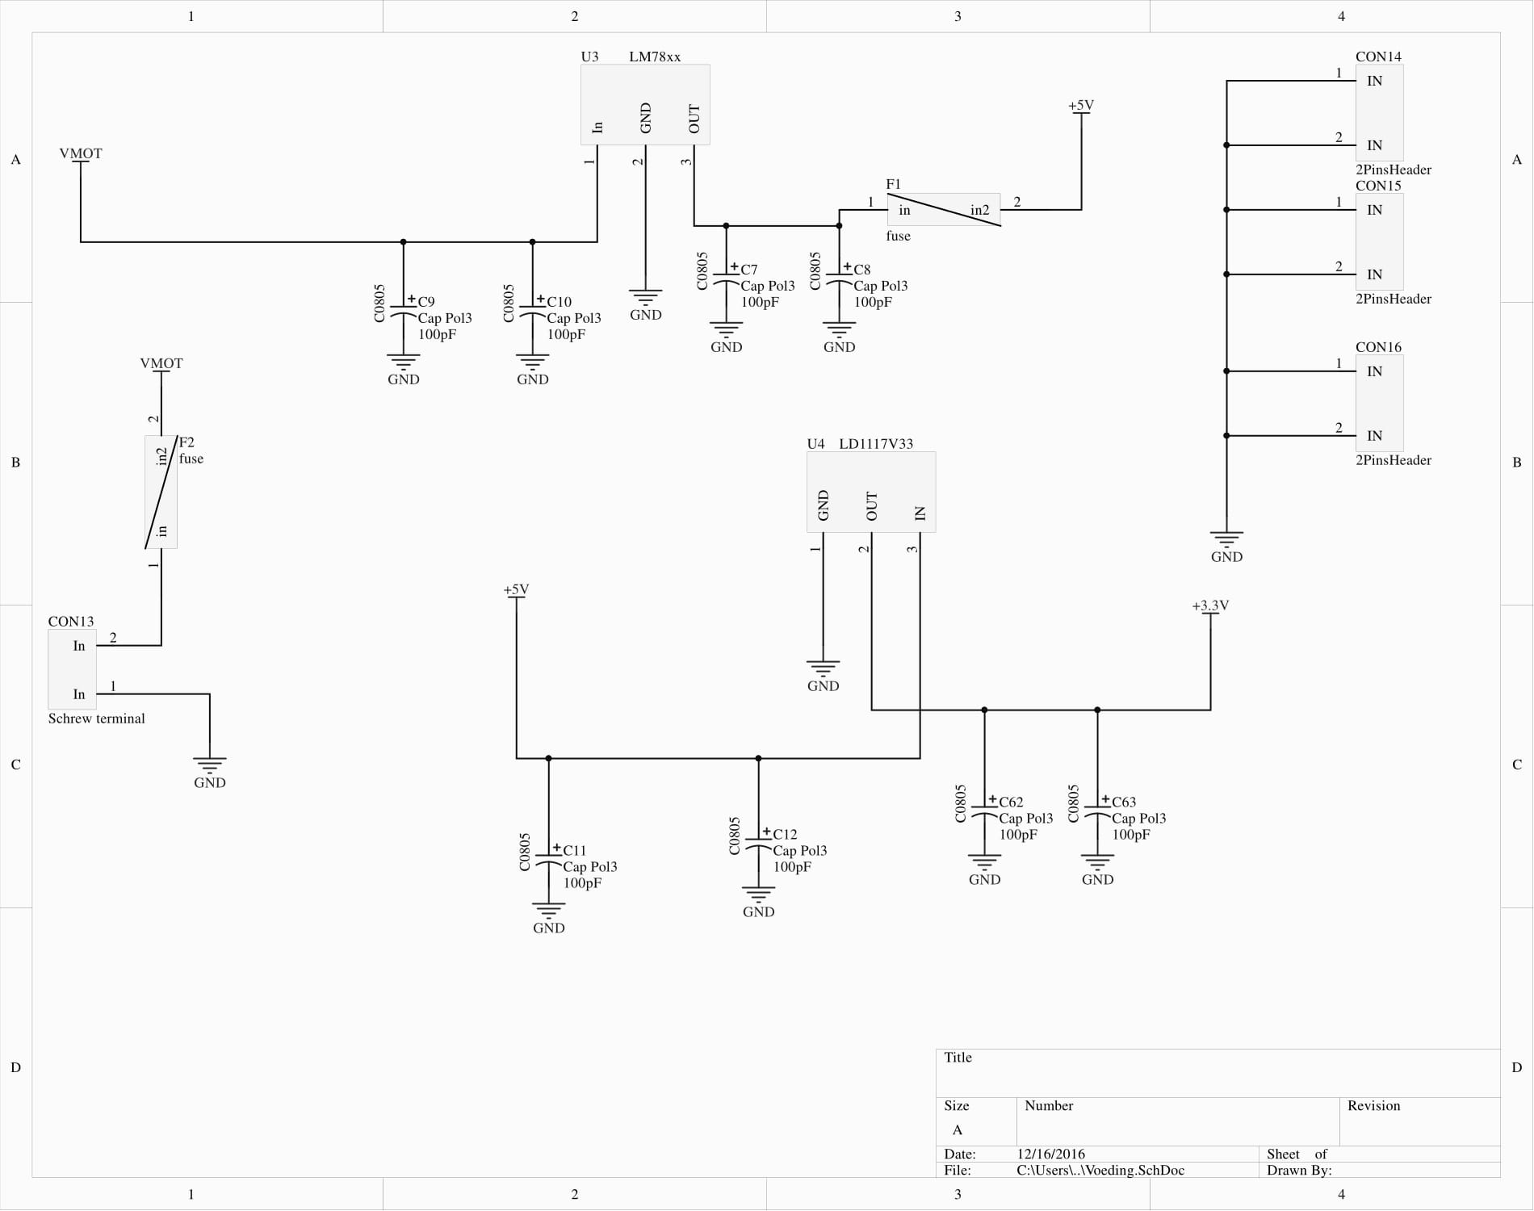
Power supply V3

Slide 31
Improvments for MK4 pcb

Slide 32
What did I learn ?
Circuit design
Think first then design
First reading the datasheet
Then draw footprints etc.
High current design
Using Altium

Slide 33
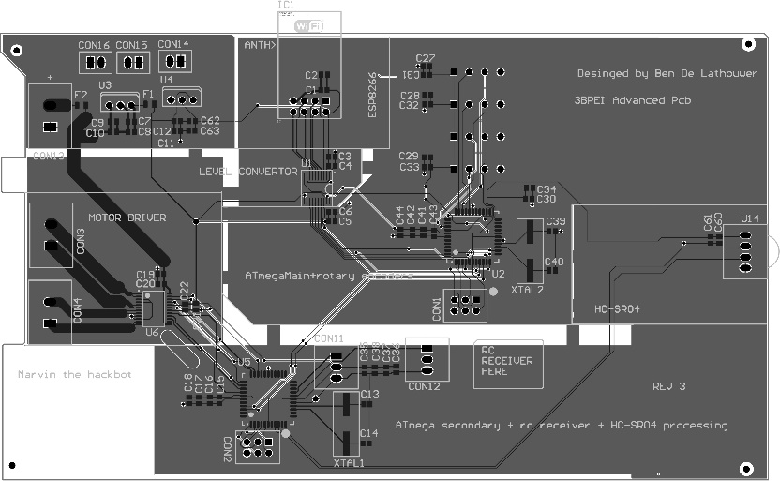
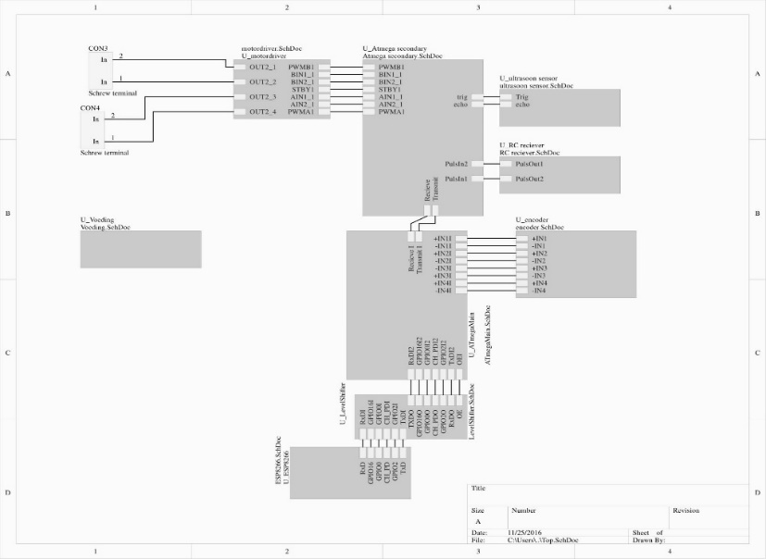
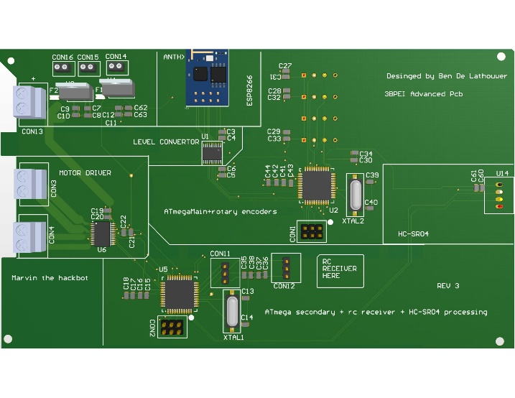
Questions?

